Slide 1

Analysis of Epidemic Spread Using Mathematical and Computational Models
Mathematical Modeling Final Project

Slide 2
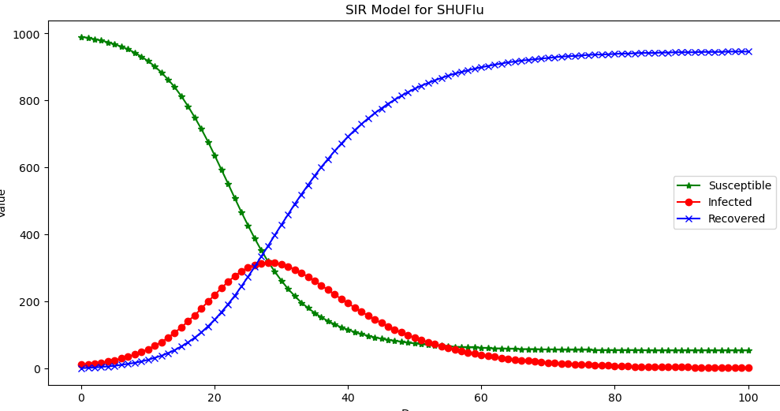
SIR Data Analysis
Recovered and susceptible have inverse relationships to one another.
There is just one singular peak in the wave, due to susceptible numbers remaining stagnant and reinfection not allowed

Slide 3
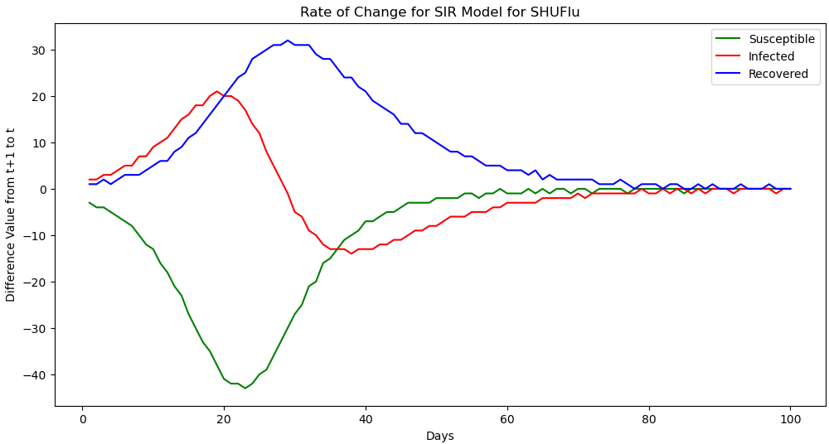
Rate of Change SIR Data Analysis
This reflects the rate of change in infection numbers from one day to the next.

Slide 4
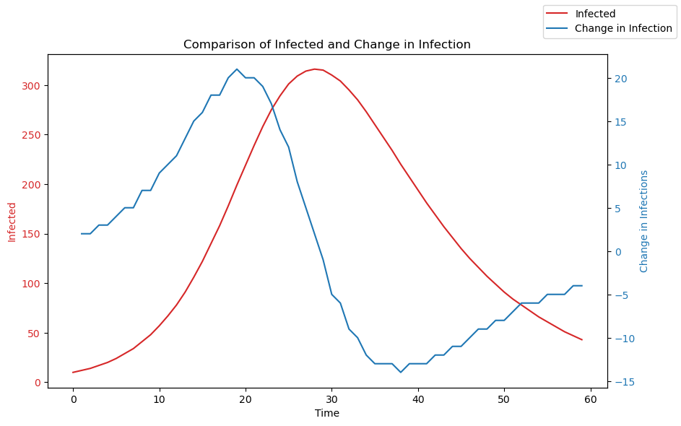
Comparing Infection Waves
The peak at day 21 represents 21 new infections per day (2% of population)
The peak at day 29 represents 316 active infections (31.6% of population)
There is an 8 day delay in these two waves which represents the importance of proactive steps

Slide 5
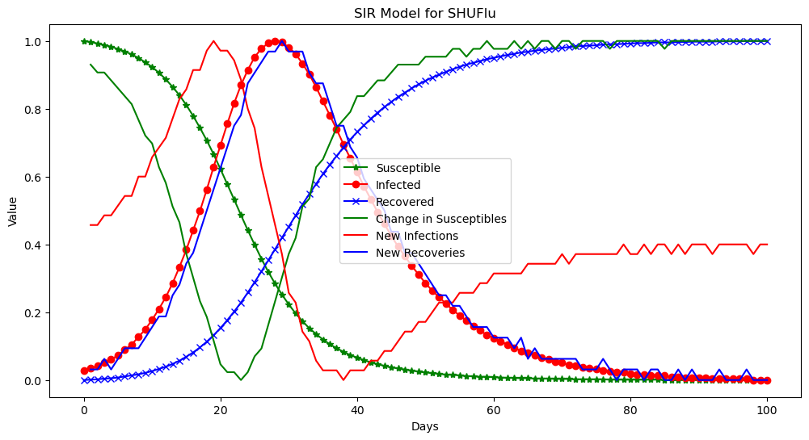
Comparing S,I,R Waves
Data has been normalized to prioritise wave movements
New recoveries and infected and active infections follow a very similar pattern
Susceptible and recovered have opposite relationships to one another
New infections and susceptibility are opposite

Slide 6
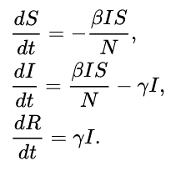
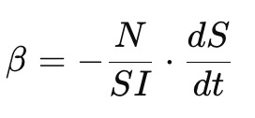
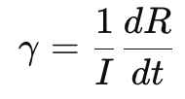
Solving for Beta and Gamma Values
Transpose change in susceptible population to be in terms of beta
Transpose change in recovered population to be in terms of gamma
Input historical data to solve for changing beta and gamma rates
See code for calculations

Slide 7
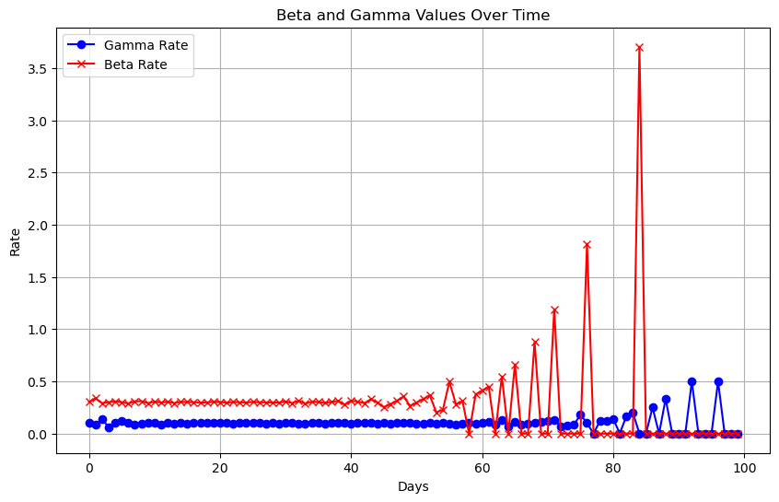
Beta and Gamma Values Over Time
Beta values average at about 0.3 until day 60 where the rates change of susceptible approaches 0
Gamma values average at about 0.1 until Day 80 where the rate of recovered people approaches 0
Beta Rate = 0.3
Gamma Rate = 0.1

Slide 8
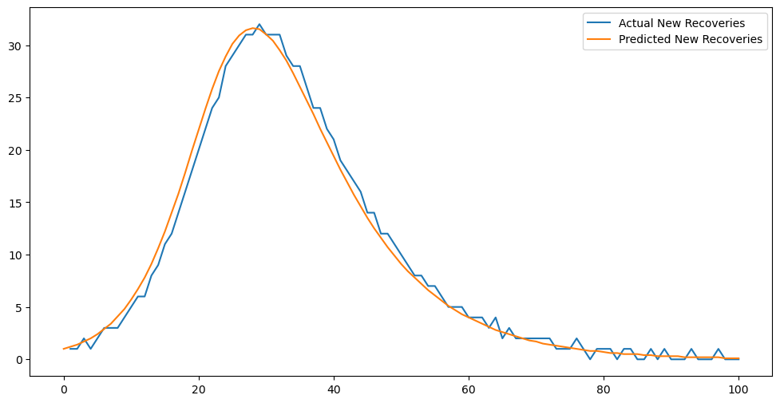
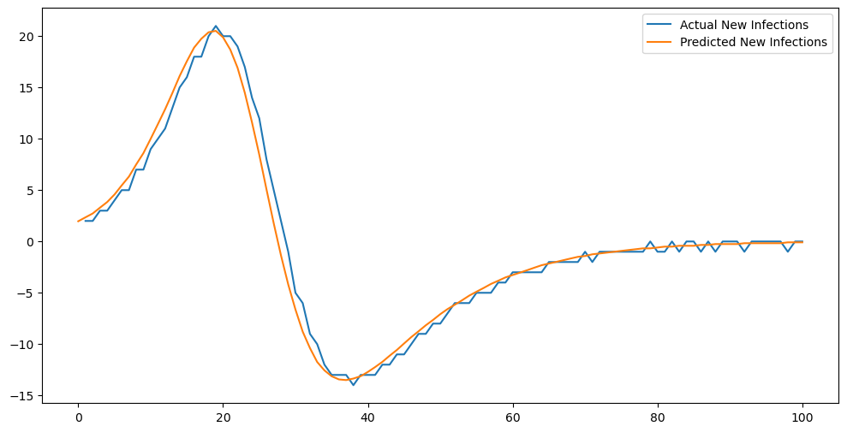
Change in Infection and Recovered

Slide 9
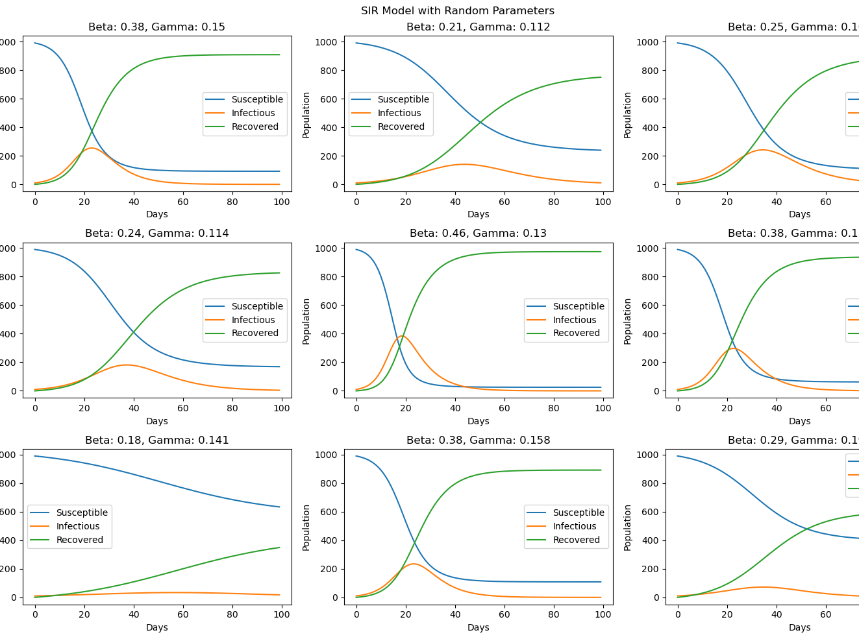
Including Uncertainty to Parameters
High beta rate + low gamma rate = high infection
Relatively same beta + gamma = low infection numbers
Slightly higher beta rate than gamma rather = smoothed out infection (flattened the curve)

Slide 10
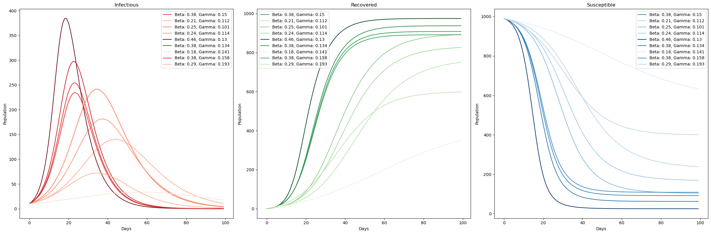
Visualizing Uncertainty in Parameters on SIR

Slide 11
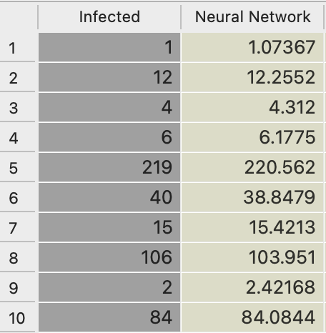
Neural Network
The higher the hidden layers, returned a more accurate model

Slide 12
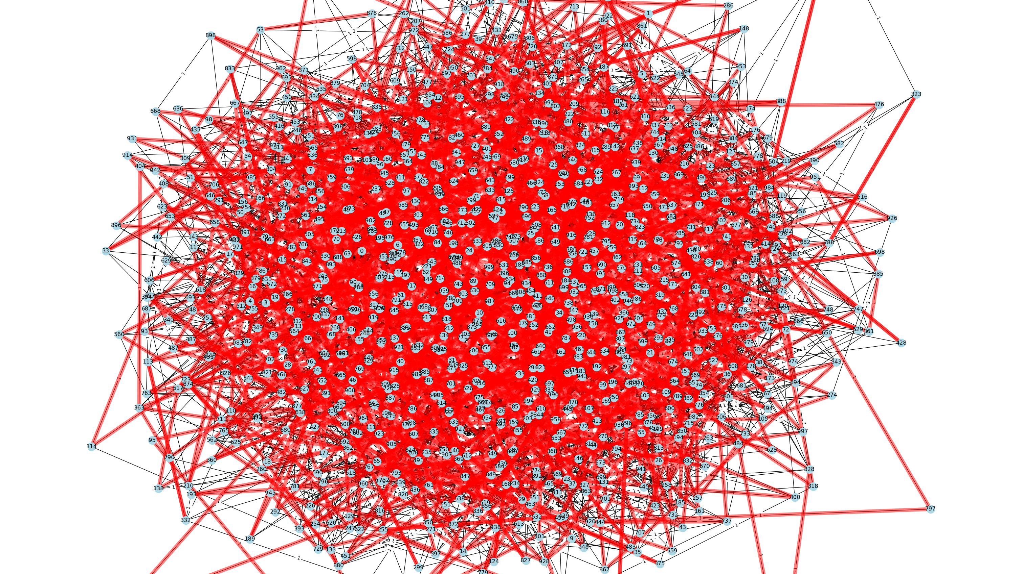

Slide 13
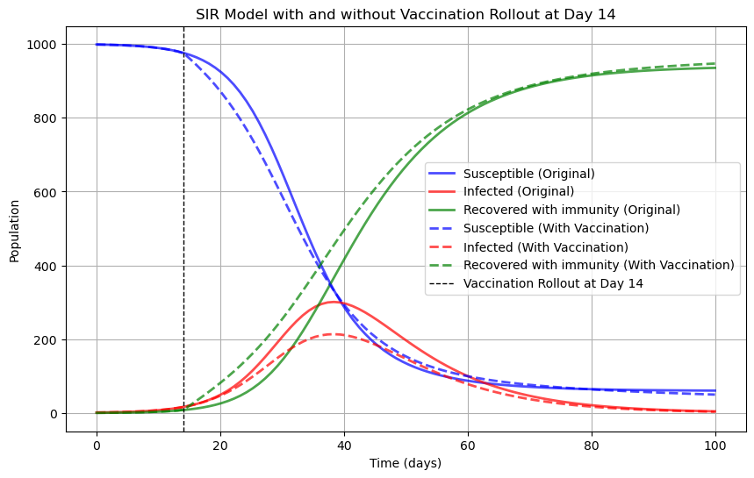
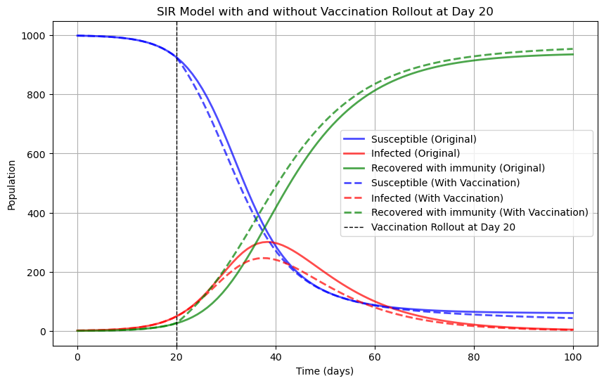
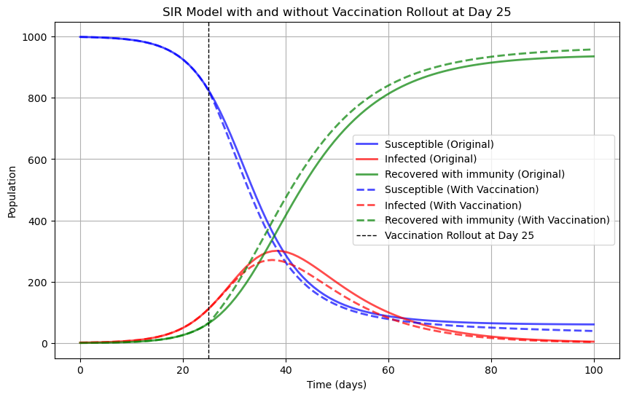
Vaccination Rates

